Slide 1

Collaborative and Hybrid Recommendation System
Bibek Shiwakoti (C0898100)
Jumana Lightwala (C0892358)
Pratikkumar Mishra (C0891298)
Ronak Shah (C0891297)

Slide 2
INTRODUCTION
The project compares hybrid recommender systems with cooperative filtering-based recommender systems.
The data set comes from the Motion Picture Lens dataset, consisting of 1682 movie studies with 100,000 users (1–5) from 943 individuals.
Each user has rated at least 20 movies.
The title of each movie will be converted into a tag word, which can be used to search for tweets on Reddit API related to that movie.
The sentiment score for each tweet of each movie will be calculated, and the sentiment score for each movie will be stored as the sentiment score of the Matrix Factorization of that movie will be used to create a recommendation algorithm based on collaboration extract and Neural Embedding layer so of PyTorch package to create hybrids They will be used.
The project report, Python files, and architectural details for the proposer will do the job in the future.
The report will follow a pre-defined format including abstract, methodology, due diligence, experimental findings and conclusion.

Slide 3
METHODOLOGY
1. Matrix Factorization 2. Neural Embedding layer

Slide 4

MATRIX FACTORISATION USING COLLABOARATIVE FILTERING USING SVD
This matrix factorization is useful in collaborative filtering to predict missing entries in the user-item matrix, i.e., to predict how a user might rate an item they haven't interacted with yet.
Where:
R is the original user-item matrix.
U is a matrix where each row represents a user in terms of latent features.
Σ is a diagonal matrix of singular values, capturing the importance of each latent feature.
V^T is a matrix where each column represents an item in terms of latent features.

Slide 5
Average, Highest and Lowest Ratings of a Movie
Highest No of Ratings for a movie title is Movie: Star Wars (1977) and ratings of 583
Lowest No of ratings for a movie title is: Scream of Stone (Schrei aus Stein) (1991) which has a rating of 1.

Slide 6
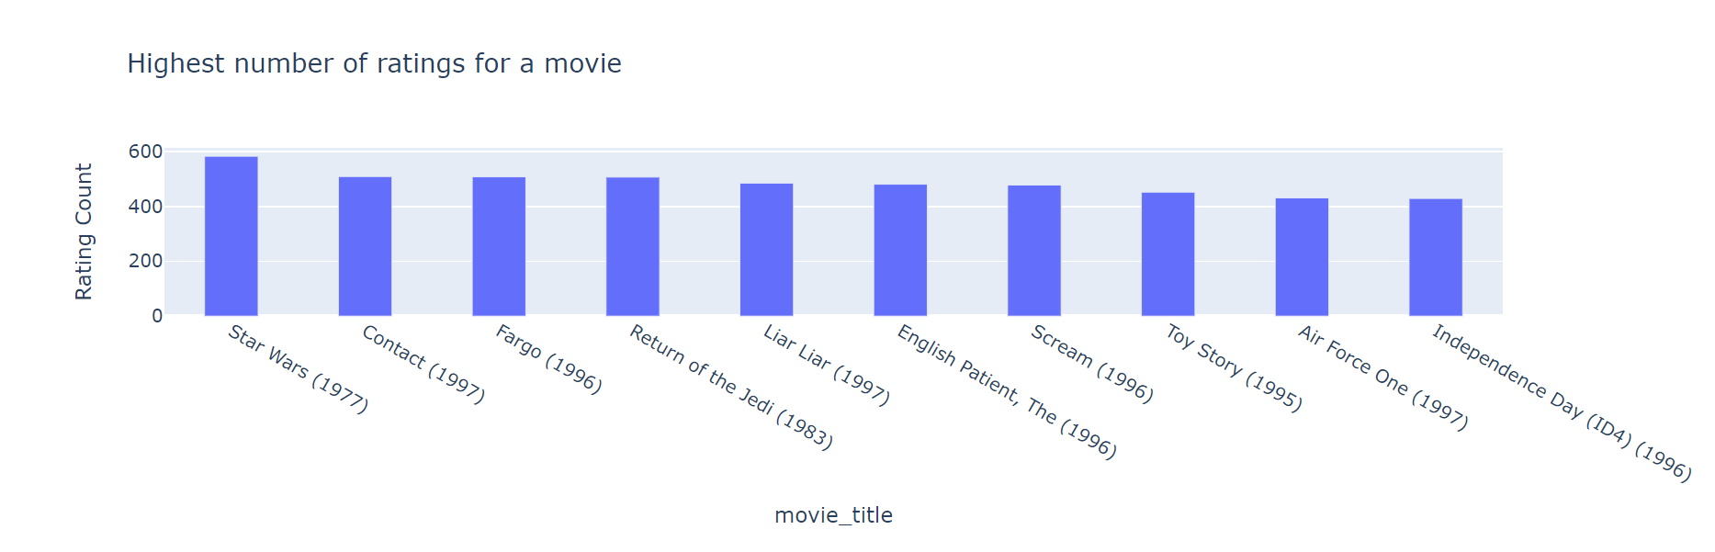
Highest number of ratings for a movie

Slide 7
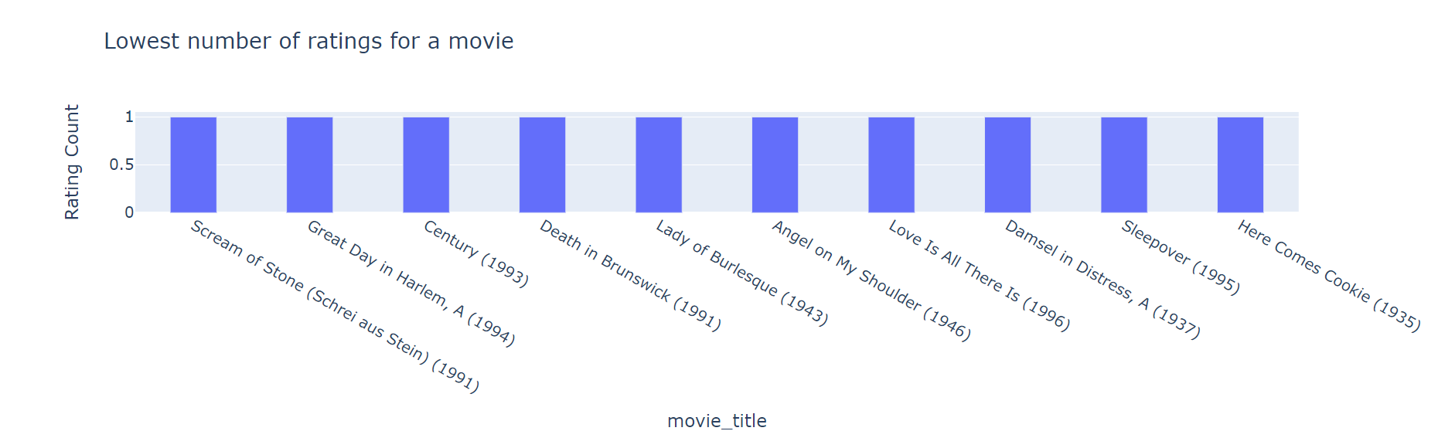
Lowest number of ratings for a movie

Slide 8
RMSE Vs Latent Vector
The graph and accompanying RMSE (Root Mean Squared Error) values demonstrate how the prediction accuracy of the recommendation system changes as the number of latent vectors in the SVD (Singular Value Decomposition) model increases.
Increasing the latent vector size leads to lower RMSE, meaning the model becomes more accurate.
The plot shows a downward trend in RMSE as the latent vector size increases.

Slide 9
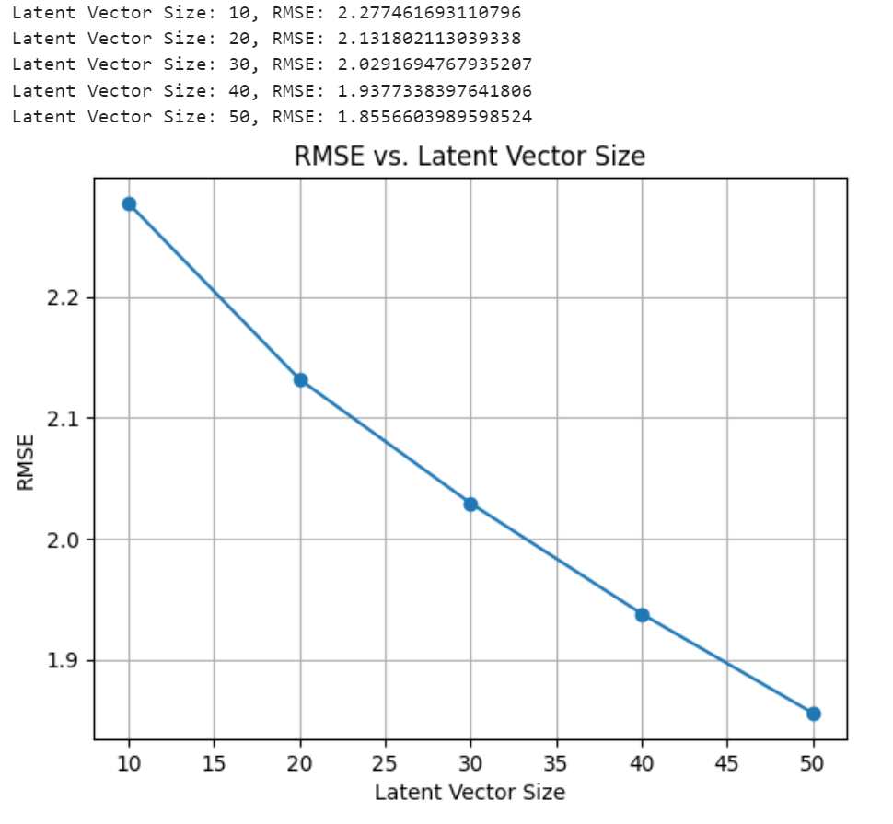

Slide 10
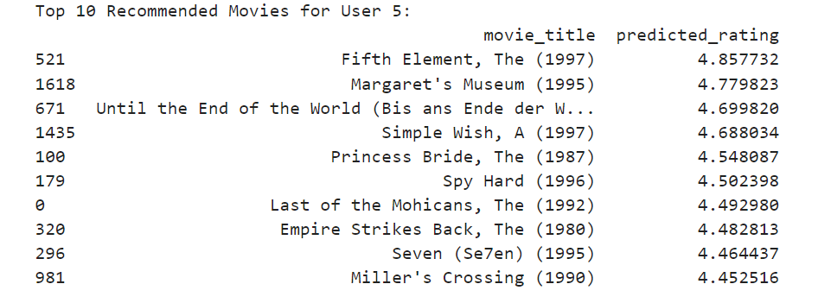
Top 10 Recommended Movies for User 5

Slide 11
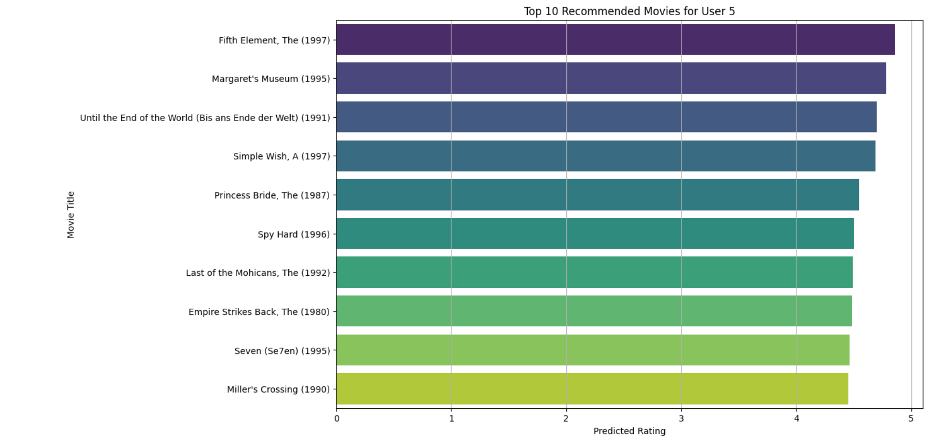

Slide 12
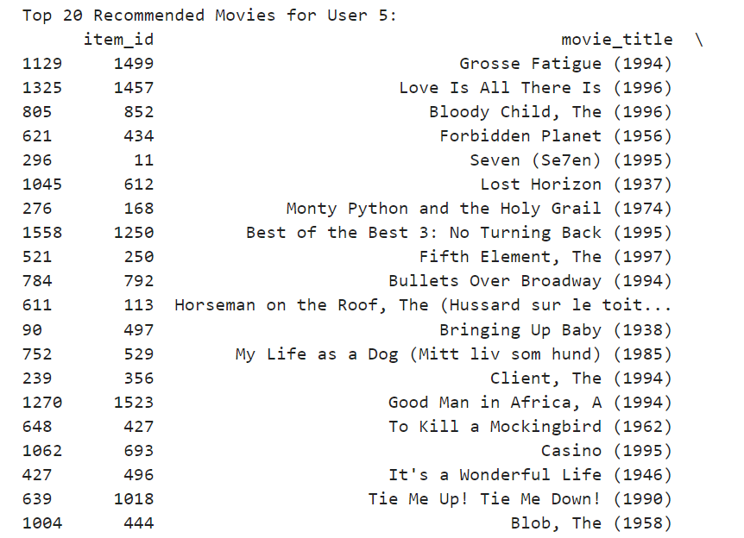
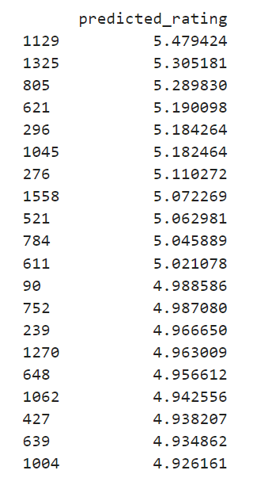
Top 20 Recommended Movies for User 7

Slide 13
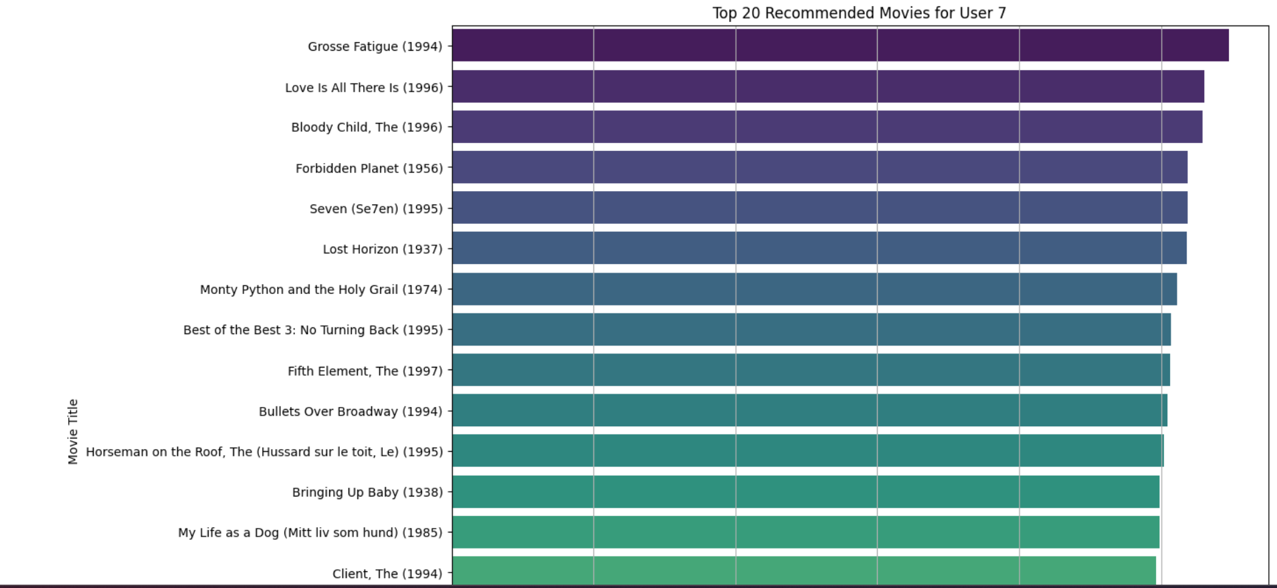

Slide 14
Activation function used
In the Hybrid-Recommender model, we have utilized the ReLU (Rectified Linear Unit) activation function in the fully connected layers (fc1 and fc2). ReLU is a commonly used activation function, particularly in deep learning, due to its simplicity and effectiveness in addressing the vanishing gradient problem.
Pros: Simple, computationally efficient, mitigates the vanishing gradient problem.
Cons: Can lead to "dead neurons" where certain neurons may stop learning entirely if they output zero consistently.

Slide 15
Training Neural Network
Input: Batches of user, item, genre, and sentiment data.
Model: Combines and processes embeddings to predict ratings.
Output: Single predicted rating per user-item pair.
Optimization: Model parameters updated to minimize prediction error.

Slide 16
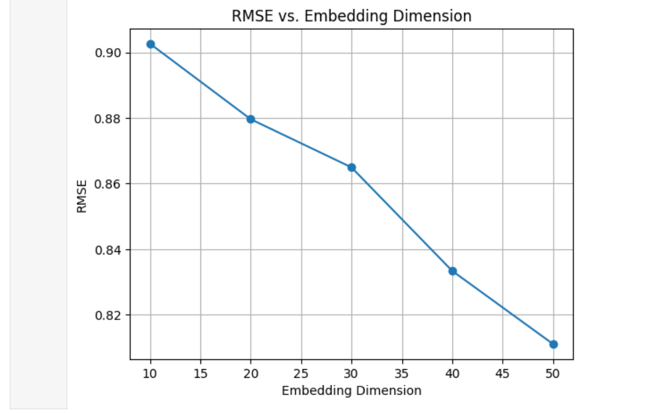
RMSE Vs Embedding Dimension

Slide 17
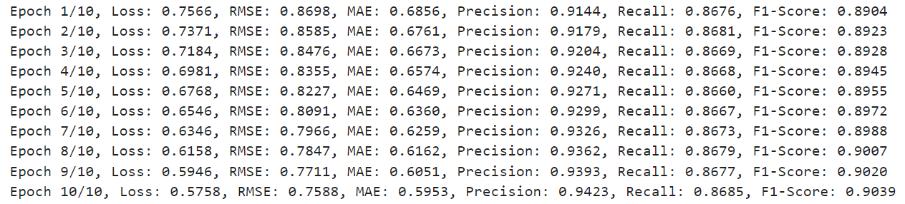
RMSE, MAE, F1-Score, Precesion, Recall
Over the 10 epochs of training, the model shows improvements in all evaluation metrics. The loss decreases steadily, indicating effective learning and optimization. The RMSE and MAE values decrease, demonstrating that the model's predictions are becoming more accurate. Precision and F1-Score improve, suggesting that the model's ability to identify relevant items and make accurate recommendations is enhancing. The recall remains stable, showing consistency in the model's performance.

Slide 18

Thank YOU

